Slide 1
Pathfinder Pro
Bharathsree S
Dineshkumar S
CRP Sravani

Slide 2
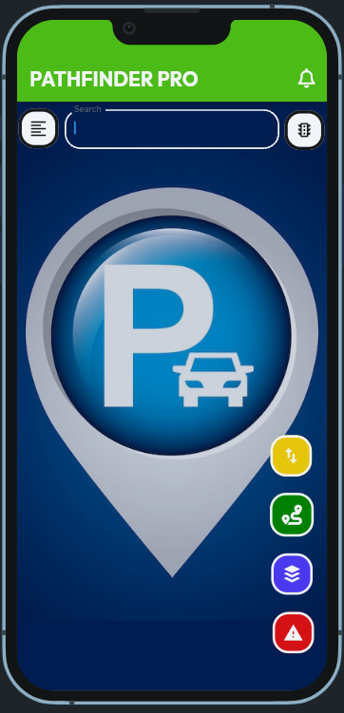
This is the homepage of our prototype “ Pathfinder Pro” where you can get access to all menu”s

Slide 3
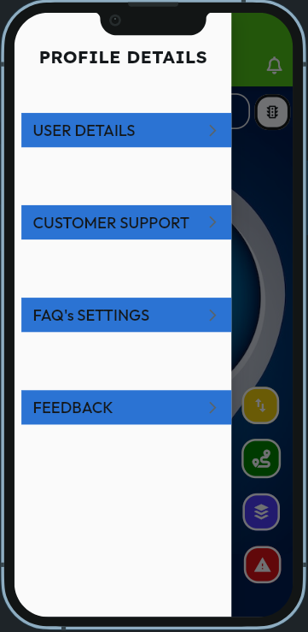
In the app's navigation menu, you have options such as user profile where you can Personalize your experience by entering your details.
If you ever need assistance or have questions, our customer support team is just a tap away.
Find quick answers to common queries in our FAQ section. customers can share their suggestions or thoughts through feedback.
It helps us to improve and enhance their experience.

Slide 4
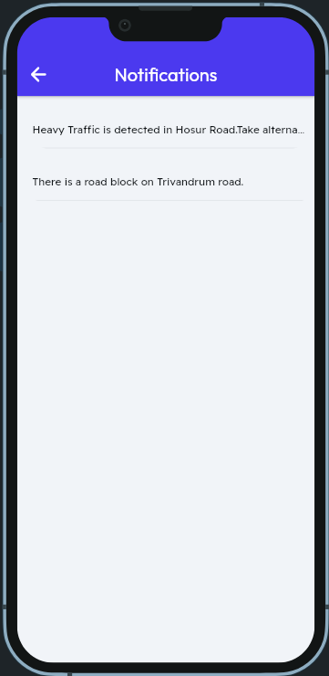
Notification Bell Icon is displayed at the top of the screen to indicate new alerts.
Users can tap it to view notifications.
Personalized push notifications enable users to receive alerts about specific traffic incidents or alternative routes keeping them informed about relevant issues

Slide 5
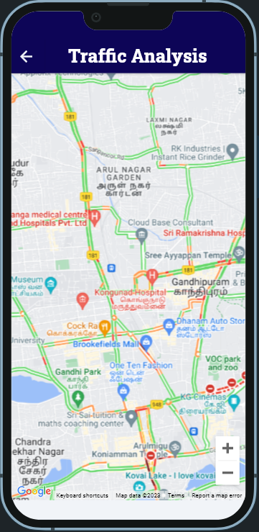
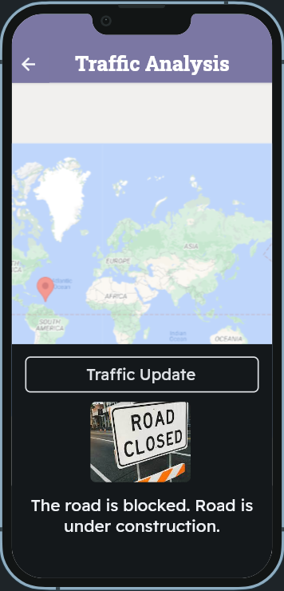
There is traffic light icon positioned in the top right corner of the app.
When tapped, it displays real-time traffic data. This ensures that users are directed to the fastest and least congested routes.
It Overlays real-time traffic information on the map, using color-coded lines (e.g., green for clear, red for congested).
It include icons for incidents (accidents, road closures) and live traffic camera views. For example we have created an icon that displays alert in their regular pathway.

Slide 6
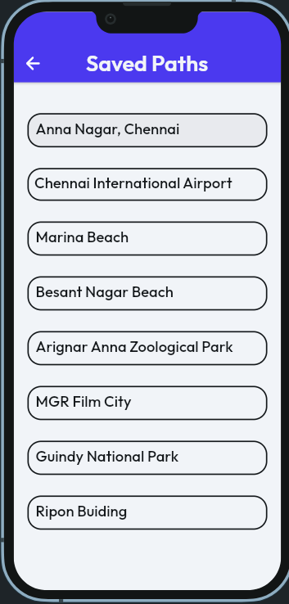
Our app provides a convenient feature called "Saved Paths" or "Saved Routes," which allows users to save and access their regular pathways or frequently traveled routes.
This feature is particularly useful for daily commuters, frequent travelers, or anyone who wants quick and easy access to their commonly used routes on the app.
It simplifies navigation, enhances user experience, and can save you time when planning your journeys.

Slide 7
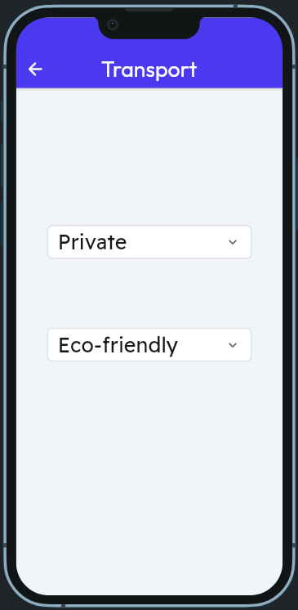
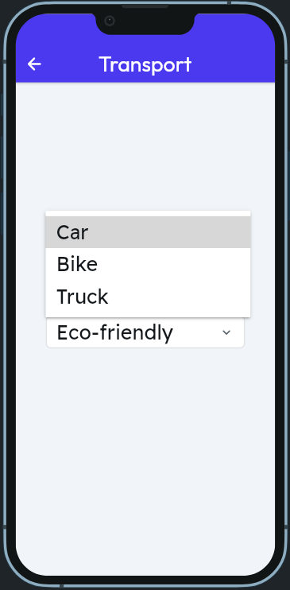
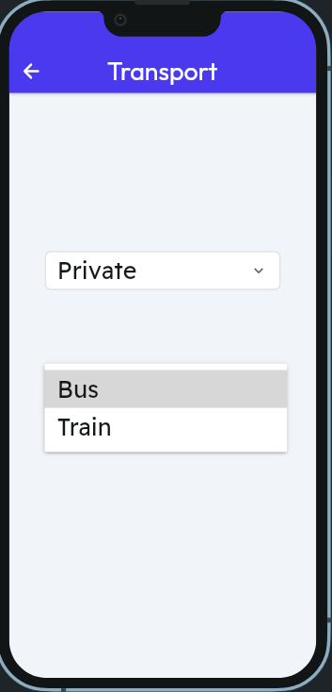
Route Options Icon: Located at the bottom of the map, providing access to different route choices.
Inside the route options, allow users to select a route type (fastest, eco-friendly, etc.).
It promotes eco-friendly travel options by suggesting public transportation, walking, or biking routes when traffic conditions are unfavorable.
If users are facing any technical issues or trouble , they can report it in report page.

Slide 8
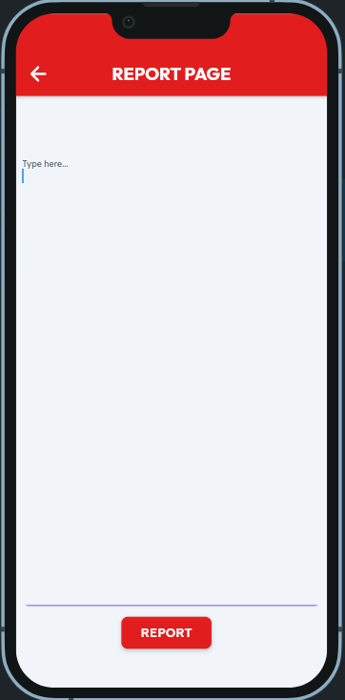
If users are facing any technical issues or trouble , they can report it in report page.
Thus we created a sample app interface. The development process for our app is iterative and involves ongoing improvements and updates to provide users with a valuable and up-to-date traffic navigation solution.

Slide 9
Thank you code with google maps team for giving this opportunity..

